Slide 1
Entrepreneurship: Evolutionary Development—Revolutionary Impact

Slide 2
Learning Objectives
To examine the historical development of entrepreneurship
To explore and debunk the myths of entrepreneurship
To define and explore the major schools of entrepreneurial thought
To explain the process and framework approaches to the study of entrepreneurship
To set forth a comprehensive definition of entrepreneurship
To examine the entrepreneurial revolution taking place today
To illustrate today’s entrepreneurial environment

Slide 3
Entrepreneurs—Breakthrough Innovators
Entrepreneurs
  Recognize opportunities where others see chaos, contradiction, or confusion
  Are aggressive catalysts for change within the marketplace
  Challenge the unknown and continuously create breakthroughs for the future

Slide 4
Entrepreneurs versus
Small Business Owners: A Distinction
Small Businesses Owners
  Manage their businesses by expecting stable sales, profits, and growth
Entrepreneurs
  Focus their efforts on innovation, profitability and sustainable growth

Slide 5
Entrepreneurship: A Mind-Set
Entrepreneurship is more than
the mere creation of business:
  Seeking opportunities
  Taking risks beyond security
  Having the tenacity to push
  an idea through to reality
Entrepreneurship is an integrated concept that permeates an individual’s business in an innovative manner.

Slide 6
The Evolution of Entrepreneurship
Entrepreneur is derived from the French entreprendre, meaning “to undertake.”
  The entrepreneur is one who undertakes to organize, manage, and assume the risks of a business.
  Although no single definition of entrepreneur exists and no one profile can represent today’s entrepreneurs, research is providing an increasingly sharper focus on the subject.

Slide 7
A Summary Description of Entrepreneurship
Entrepreneurship (Robert C. Ronstadt)
  The dynamic process of creating incremental wealth.
  This wealth is created by individuals who assume major risks in terms of equity, time, and/or career commitment of providing value for a product or service.
  The product or service itself may or may not be new or unique but the entrepreneur must somehow infuse value by securing and allocating the necessary skills and resources.

Slide 8
An Integrated Definition
Entrepreneurship
  A dynamic process of vision, change, and creation.
    Requires an application of energy and passion towards the creation and implementation of new ideas and creative solutions.
  Essential ingredients include:
    The willingness to take calculated risks—in terms of time, equity, or career.
    The ability to formulate an effective venture team; the creative skill to marshal needed resources.
    The fundamental skills of building a solid business plan.
    The vision to recognize opportunity where others see chaos, contradiction, and confusion.

Slide 9
Avoiding Folklore:
The Myths of Entrepreneurship
Myth 1: Entrepreneurs Are Doers, Not Thinkers
Myth 2: Entrepreneurs Are Born, Not Made
Myth 3: Entrepreneurs Are Always Inventors
Myth 4: Entrepreneurs Are Academic and Social Misfits
Myth 5: Entrepreneurs Must Fit the Profile
Myth 6: All Entrepreneurs Need Is Money
Myth 7: All Entrepreneurs Need Is Luck
Myth 8: Entrepreneurship Is Unstructured and Chaotic
Myth 9: Most Entrepreneurial Initiatives Fail
Myth 10: Entrepreneurs Are Extreme Risk Takers

Slide 10
The Entrepreneurial Process
Types of people involved with contemporary small businesses:
  The entrepreneur who invents a business that works without him or her.
  The manager who produces results through employees by developing and implementing effective systems and, by interacting with employees, enhances their self-esteem and ability to produce good results.
  The technician who performs specific tasks according to systems and standards management developed.
Source: Adapted from Michael E. Gerber, The E-Myth Revisited: Why Most Businesses Don’t Work and What to Do About It (New York: Harper Collins,
1995, 2001) and personal interview.

Slide 11
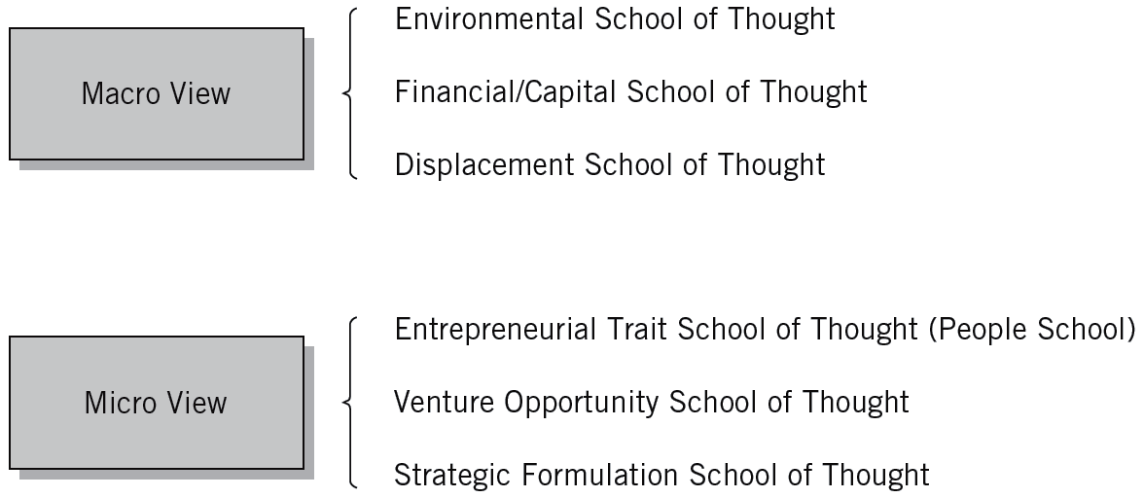
1.1 Entrepreneurial Schools-of-Thought Approach
Table

Slide 12
Macro View: External Locus of Control
The Environmental School of Thought
  Considers the external factors that affect a potential entrepreneur’s lifestyle.
The Financial/Capital School of Thought
  Based on the capital-seeking process—the search for seed and growth capital.
The Displacement School of Thought
  Alienation drives entrepreneurial pursuits
    Political displacement (laws, policies, and regulations)
    Cultural displacement (preclusion of social groups)
    Economic displacement (economic variations)

Slide 13
1.1 Financial Analysis Emphasis
Venture Stage | Financial Consideration | Decision
Start-up or acquisition | Seed capital Venture capital sources | Proceed or abandon
Ongoing | Cash management Investments Financial analysis and evaluation | Maintain, increase, or reduce size
Decline or succession | Profit question Corporate buyout Succession question | Sell, retire, or dissolve operations

Slide 14
Micro View: Internal Locus of Control
The Entrepreneurial Trait School of Thought
  Focuses on identifying traits common to successful entrepreneurs.
    Achievement, creativity, determination, and technical knowledge
The Venture Opportunity School of Thought
  Focuses on the opportunity aspect of venture development—the search for idea sources, the development of concepts, and the implementation of venture opportunities.
    Corridor principle: New pathways or opportunities will arise that lead entrepreneurs in different directions.

Slide 15
Micro View… (cont’d)
The Strategic Formulation School of Thought
  Emphasizes the planning process in successful venture development.
  Strategic formulation is a leveraging of unique elements:
    Unique Markets—mountain gap strategies
    Unique People—great chef strategies
    Unique Products—better widget strategies
    Unique Resources—water well strategies

Slide 16
Process Approaches to Entrepreneurship
An Integrative Approach
  Built around the concepts of input to the entrepreneurial process and outcomes from the entrepreneurial process.
  Focuses on the entrepreneurial process itself and identifies five key elements that contribute to the process.
  Provides a comprehensive picture regarding the nature of entrepreneurship that can be applied at different levels.

Slide 17
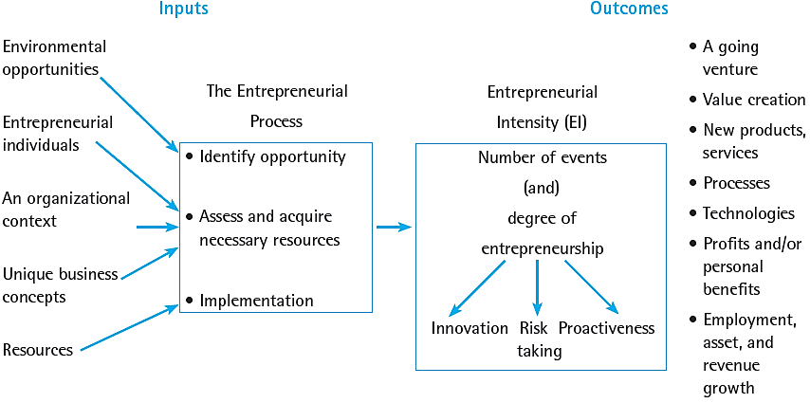
1.2 An Integrative Model of Entrepreneurial Inputs and Outcomes
Source: Michael H. Morris, P. Lewis, and Donald L. Sexton, “Reconceptualizing Entrepreneurship: An Input-Output Perspective,” SAM Advanced Management Journal 59, no.1 (Winter 1994): 21–31.

Slide 18
Process Approaches… (cont’d)
Dynamic States Approach
  Stresses dependency of venture on environment and the interaction of:
    The dominant logic of the firm
    The business model
    Value creation

Slide 19
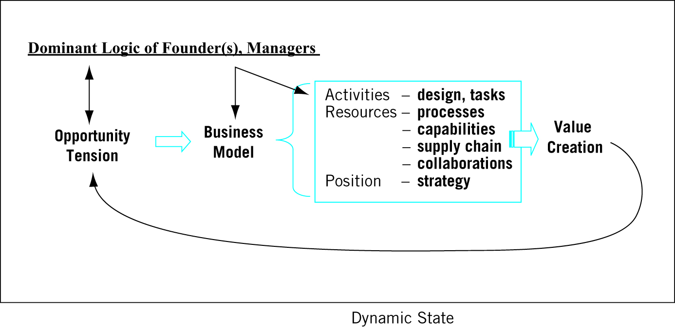
1.3 Dynamic States Approach
Source: Jonathan Levie & Benjamin B. Lichtenstein, (2010). “A Terminal Assessment of Stages Theory: Introducing a Dynamic States Approach to Entrepreneurship,” Entrepreneurship Theory and Practice, 34, no. 2 (2010): 332. Reproduced with permission of John Wiley & Sons Ltd..

Slide 20
Process Approaches… (cont’d)
A Framework of Frameworks Approach
  Offers a more dynamic view of entrepreneurship.
  Allows for the profession to move forward.
  Identifies the static and dynamic elements of new theories, typologies, or frameworks of importance.

Slide 21
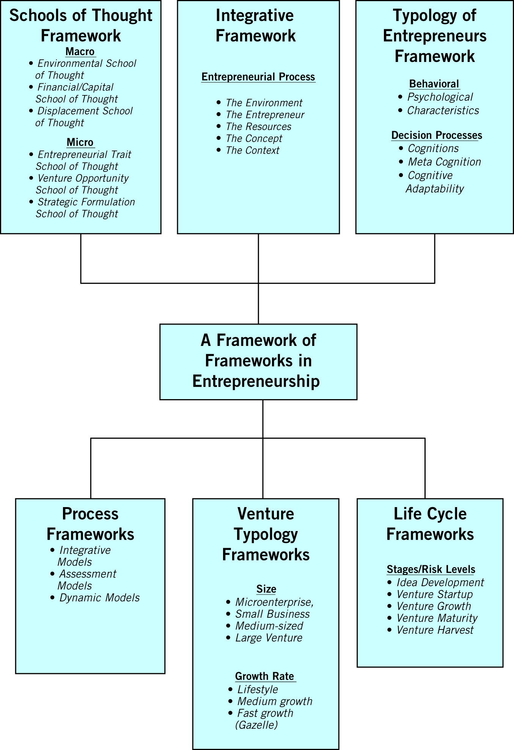
1.4 A Framework of Frameworks Approach
Source: Donald F. Kuratko, Michael H. Morris, and Minet Schindehutte, “Understanding the Dynamics of Entrepreneurship through Framework Approaches,” Small Business Economics, 45, no. 1 (2015): 9. Berlin, Germany; Springer Publishing.

Slide 22
The Entrepreneurial Revolution:
A Global Phenomenon
Entrepreneurship is the symbol of business tenacity and achievement.
Entrepreneurs were the pioneers of today’s business successes.
Two perspectives on entrepreneurship:
  Statistical: numbers that emphasize the importance of entrepreneurs to the economy.
  Academic: trends in entrepreneurial research and education.

Slide 23
Effects of Entrepreneurship
The Global Entrepreneurship Monitor (GEM)
  Provides an annual assessment of the entrepreneurial environment of over 100 countries.
  Latest GEM study: the U.S. outranks the rest of the world in important entrepreneurial support.
Entrepreneurs lead to growth by:
  Entering and expanding existing markets.
  Creating entirely new markets by offering innovative products.
  Increasing diversity and fostering minority participation in the economy.

Slide 24
Phases of Economic Development
The
factor-driven phase
The efficiency-driven phase
The innovation-driven phase

Slide 25
Lessons from the GEM Study
Entrepreneurship
Impacts economic measures for growth, innovation, and internationalization.
1
Needs both dynamism and stability for the creation of new businesses and the exit of nonviable ones
2
Requires a variety of business phases and types and different types of entrepreneurs including women and age groups
3
Works best when there is a strong set of basic economic requirements in place to reinforce efficiency enhancers
4
Flourishes when there is broad societal acceptance of the entrepreneurial mind-set
5

Slide 26
Predominance of New Ventures in the U.S. Economy
Entrepreneurial Activity in the United States:
Growth in Small Businesses
  Entrepreneurs create over 400,000 new businesses each year.
  28.2 million small firms provide 49.6 % of private-sector jobs and make up 99.7 % of employing firms.
  Over the past five years, the number of minority-owned firms increased 45.6% while women-owned businesses increased 20.1%.
  1 of every 150 adults participates in the founding
  of a new firm each year

Slide 27
Entrepreneurial Ventures in the United States
Reasons for the exceptional entrepreneurial activity in the U.S. include:
  A national culture that supports risk taking and seeking opportunities.
  Americans’ alertness to unexploited economic opportunity and a low fear of failure.
  U.S. leadership in entrepreneurship education at both the undergraduate and graduate level.
  A high percentage of individuals with professional, technological or business degrees who are likely to become entrepreneurs.

Slide 28
The Impact of Gazelles
A “Gazelle”
  A business establishment with at least 20% sales growth in each year for five years, starting with a base of at least $100,000 in annual sales.
Gazelles as leaders in innovation:
  Are responsible for 55% of innovations in 362 different industries and 95% of radical innovations.
  Produce twice as many product innovations per employee as do larger firms.
  Obtain more patents per sales dollar than do larger firms.

Slide 29
1.2 Mythology Associated with Gazelles
Gazelles are the goal of all entrepreneurs.
Gazelles receive venture capital.
Gazelles were never mice.
Gazelles are high-tech.
Gazelles are global.
Source: NFIB Small Business Policy Guide (Washington, D.C., November 2000), 31.

Slide 30
Gazelles And Survival
How many gazelles survive?
  The simple answer is “none.”
  Sooner or later, all companies wither and die.
The Common Myth of Failure:
  85% of all firms fail in the first year—in actuality, about half of all start-ups last between 5 and 7 years.

Slide 31
Legacy of Entrepreneurial Firms
Entrepreneurial components
of the U.S. Economy:
  Large firms have increased profitability by returning to their “core competencies through restructuring and downsizing.
  New entrepreneurial companies have been blossoming in new technologies and new markets.
  Thousands of smaller firms established by women, minorities, and immigrants have strengthened the economy.

Slide 32
Entrepreneurial Firms’ Economic Impact
Entrepreneurial firms make two indispensable contributions to an economy:
  They are an integral part of the renewal process that pervades and defines market economies.
  They are the essential mechanism by which millions enter the economic and social mainstream of society.

Slide 33


21st Century Trends in Entrepreneurship Research
Venture
Financing
Corporate Entrepreneurship
Social Entrepreneurship
Trends in Entrepreneurship Research
Entrepreneurial Cognition
Women
and Minority Entrepreneurs
Global Entrepreneurial Movement
Entrepreneurial Education
Family
Businesses

Slide 34
21st Century Trends in Entrepreneurship Research
Major Research Themes:
  Venture Financing: venture capital and angel capital financing and other financing techniques strengthened in the 1990s.
  Corporate Entrepreneurship and the need for entrepreneurial cultures has drawn increased attention.
  Social Entrepreneurship has unprecedented strength within
  the new generation of entrepreneurs.
  Entrepreneurial Cognition is providing new insights into the psychological aspects of the entrepreneurial process.
  Women and Minority Entrepreneurs appear to face obstacles and difficulties different from those that other entrepreneurs face.
  The Global Entrepreneurial Movement is increasing.

Slide 35
21st Century Trends in Entrepreneurship Research (cont’d)
Major Research Themes (cont’d):
  Family Businesses have become a stronger focus of research.
  Entrepreneurial Education has become one of the hottest topics in business and engineering schools throughout the world.

Slide 36
The Entrepreneurial Process
The Best Business Schools for Entrepreneurship
Best Graduate Programs
in Entrepreneurship
Best Undergraduate Programs in Entrepreneurship
Indiana University–Bloomington**
Stanford University
Harvard University
Massachusetts Institute
of Technology
University of California–Berkeley**
Babson College
Indiana University–Bloomington**
University of Pennsylvania
University of Southern California
University of Arizona**
Babson College
**denotes public university
Source: Adapted from “Best Colleges for Aspiring Entrepreneurs,” Fortune Small Business (2007); “Venture Education,” Fortune Magazine (2010); and “Best Business School Rankings” U.S. News & World Report (2007 through 2015);

Slide 37
Key Entrepreneurship Concepts
Entrepreneurship
  A process of innovation and new-venture creation through four major dimensions—individual, organizational, environmental, and process—that is aided by collaborative networks in government, education, and institutions.
Entrepreneur
  A catalyst for economic change who uses purposeful searching, careful planning, and sound judgment when carrying out the entrepreneurial process.

Slide 38
Key Concepts (cont’d)
Entrepreneurial Discipline
  It matters not who or what the entrepreneur is—a business or a non-business public service organization, whether a governmental or non-governmental institution.
  The rules are much the same and so are the kinds of innovation and where to look for them.

Slide 39
Key Concepts (cont’d)
Entrepreneurial Leadership
  Combining two capacities of the pursuit of innovation.
    Capacity to lead
    Capacity to risk
  Leadership is measured.
    Sense of opportunity
    Drive to innovate
    Capacity for accomplishment
  One of the most significant phrases in the twenty-first century.

Slide 40
Key Terms and Concepts
better widget strategies
corridor principle
displacement school of thought
dynamic states model
entrepreneur
entrepreneurial discipline
entrepreneurial leadership
Entrepreneurial Revolution
entrepreneurial trait school of thought
entrepreneurship
environmental school of thought
external locus of control
financial/capital school of thought
framework of frameworks
gazelle
great chef strategies
internal locus of control
macro view of entrepreneurship
micro view of entrepreneurship
mountain gap strategies
strategic formulation school of thought
venture opportunity school of thought
water well strategies

